Slide 1
RBTRIST
Team 4
20163997 서희재
20186322 서혜원
20185122 임혜정
20186085 최재은

Slide 2
Contents
Background of Implementation
Key idea
Implementation description
Result
Discussion

Slide 3
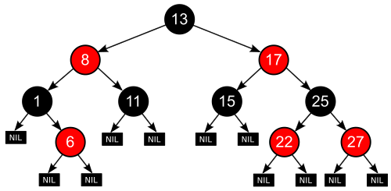
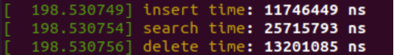
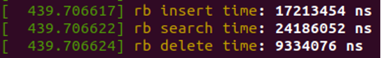
Background of Implementation
problem
Since recoloring is required, the whole tree holds a lock when the node is changed.
Due to locking overhead, the performance of
multi-threading red-black tree is rather worse.
critical
section
RB tree
multi threading RB tree

Slide 4
Key Idea : Linked list in leaf nodes of rb tree
To multi-thread & obtain the parallelism effect, the size of critical section should be smaller.
critical
section
critical section

Slide 5
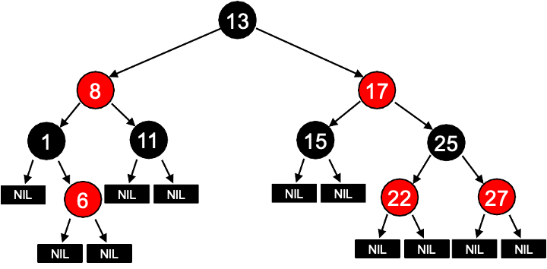



Key Idea : Linked list in leaf nodes of rb tree
When inserting, the data is inserted in the linked list node.
Doesn’t carry out coloring immediately.

Slide 6






Benefits
Each workload just need to acquire lock of leaf node which contains linked list.
Therefore, multithreading effect is achieved.

Slide 7
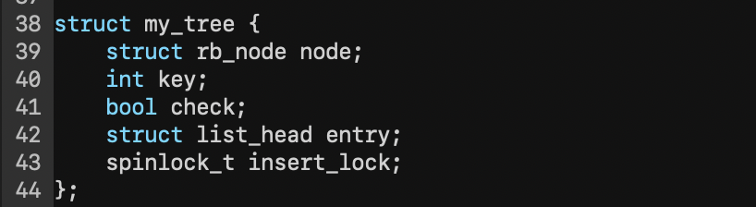
rbtrist implementation
rbtree + linked list structure
rb_node + list_head
key : data
check : whether the leaf node is a list head or not
insert_lock : used when a thread inserts a node into a leaf node list. ’spin_lock_init’ required.
leaf node buffer, global buffer index variable
buffer : the address of leaf nodes with linked list
buffer_idx : where to put next leaf node(in buffer array)

Slide 8
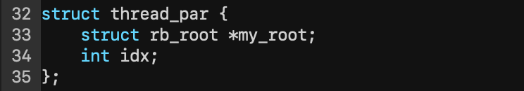
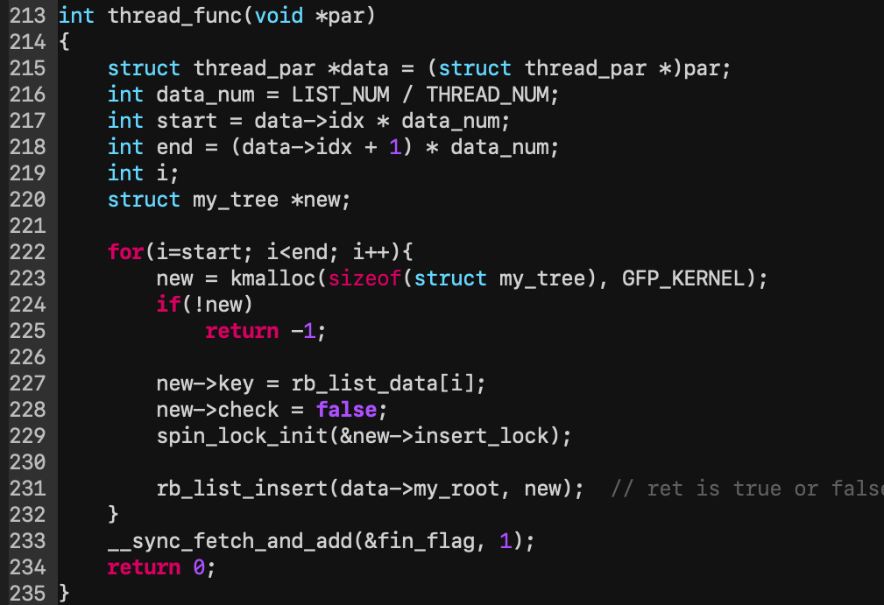
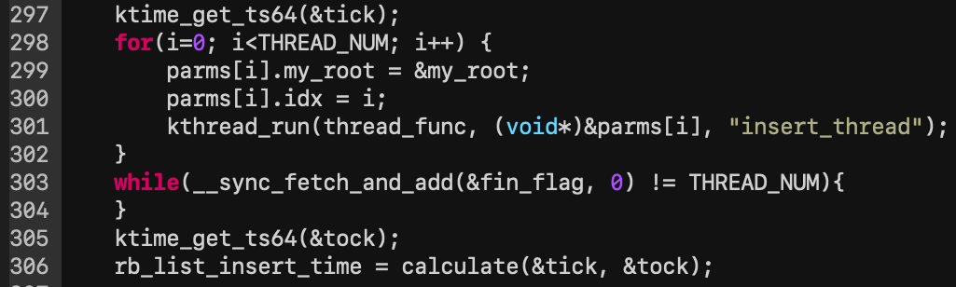
rbtrist implementation
Thread function
- 100,000 rbtrist nodes are inserted concurrently into the existing normal rbtree with 100,000 nodes.

Slide 9
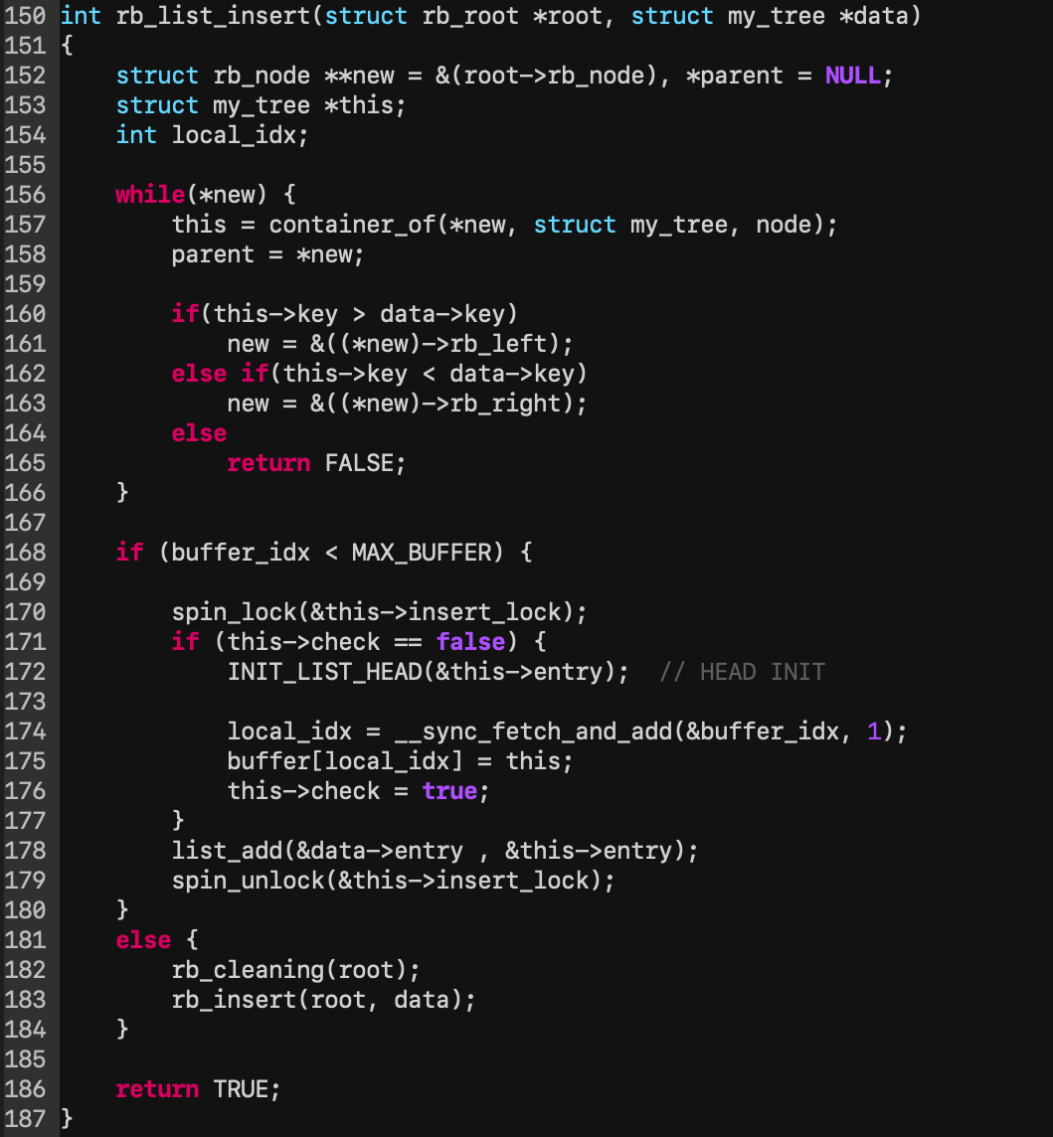
rbtrist implementation
rbtrist insert

Slide 10
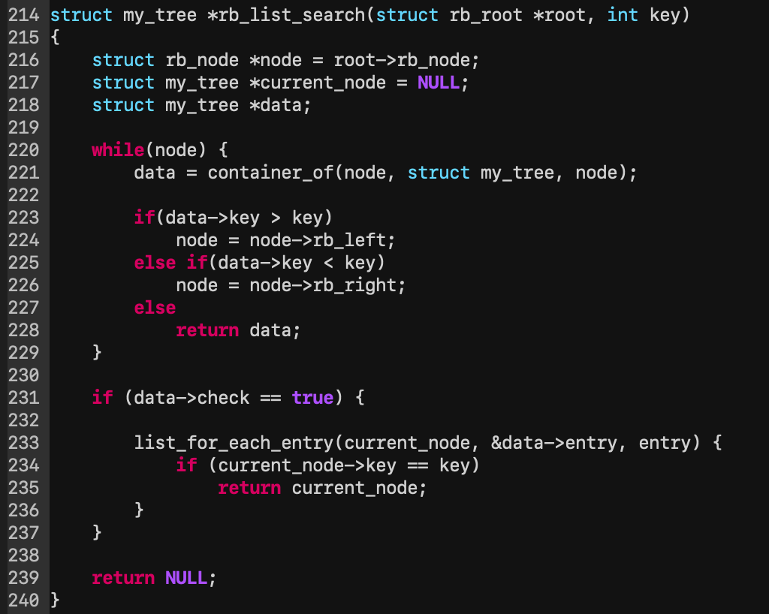
rbtrist implementation
rbtrist search : combination of rbtree search and linked list search

Slide 11
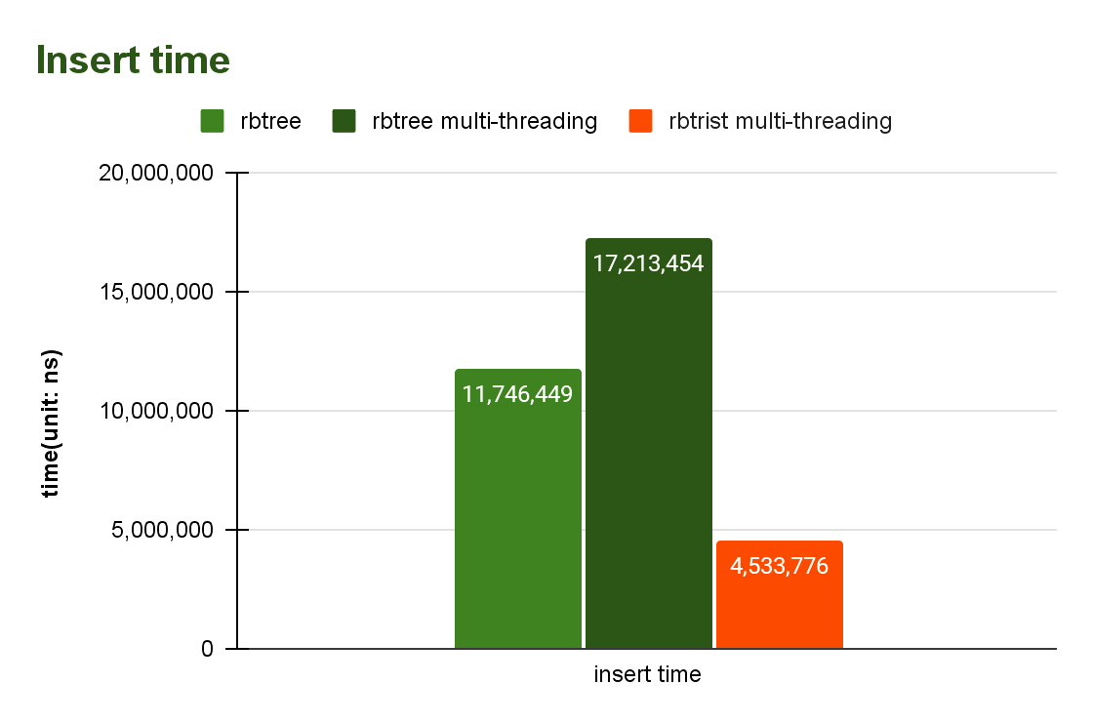
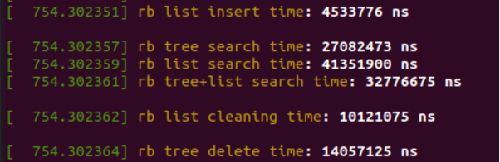
Result
Experiment environment
OS: Ubuntu 20.04, kernel: 5.11.10
Core: 11th Gen Intel Core i7-1165G7 2.80GHz
RAM: 16GB, SSD: 512GB the number of thread : 8
About 2.6x better performance than the original rbtree insert time.
About 3.8x better performance than multi-threading rbtree insert time

Slide 12
Discussion
Extra searching time issue
Extra searching time is not much costly.
search list data ½ + tree data ½ : takes 1.2x more time
search all list data (worst case) : takes 1.6x more time

Slide 13
Discussion
Extra searching time issue
2. Cleaning function also solves this trivial issue perfectly.
When reaching the threshold(MAX_BUFFER), it calls rb_cleaning() and clean up the list.
It doesn’t take a long time for cleaning because recoloring time is not long.
If cleaning is executed in advance when data structure idle, it’s more efficient.
=> A little extra searching time saves the insertion time.

Slide 14
DEMO of RBTRIST

